Slide 1
Inventory Management through CRUD
By
M Nikitha
S Hima Bindu Sri

Slide 2
Content
Introduction to NodeJS
Introduction to Express JS
Installing and using Express
Routes
Example of webserver using Express
EJS
MongoDB

Slide 3
Introduction to Node.js
Node.js is an open-source, cross-platform runtime environment.
Node.js was developed in 2009 by Ryan Dahl.
It is used for development of server-side web applications.
Node.js applications are written in JavaScript.
Google provide V8 Java script engine for the Chrome web browser.
Dahl created Node.js on top of V8 as a server side environment that matched with the client side environment.
The result is an extremely scalable server-side environment that allows developers to more easily bridge the gap between client and server.

Slide 4
Applications of Node.js
Node.js is best for usage in event-based real-time applications like
Chat applications
Game servers
Good for collaborative environment
Advertisement servers
Streaming servers (Audio, Video)
Single page Applications
Notes:
Advertisement servers – Again here you could have thousands of request to pull advertisements from the central server and Node.js can be an ideal framework to handle this.
Streaming servers – Another ideal scenario to use Node is for multimedia streaming servers wherein clients have request's to pull different multimedia contents from this server.

Slide 5
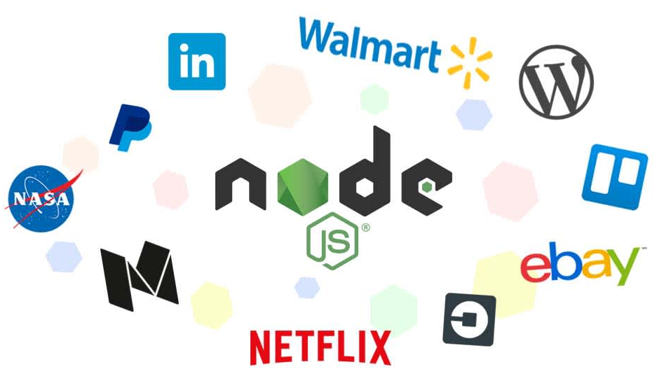


Node.js Users
Netflix
Trello
Paypal
LinkedIn
Mozilla
Walmart
Uber
Groupon
Ebay
Nasa
Yahoo
Twitter
GoDaddy
Notes:
Node.js is used by a variety of large companies.

Slide 6
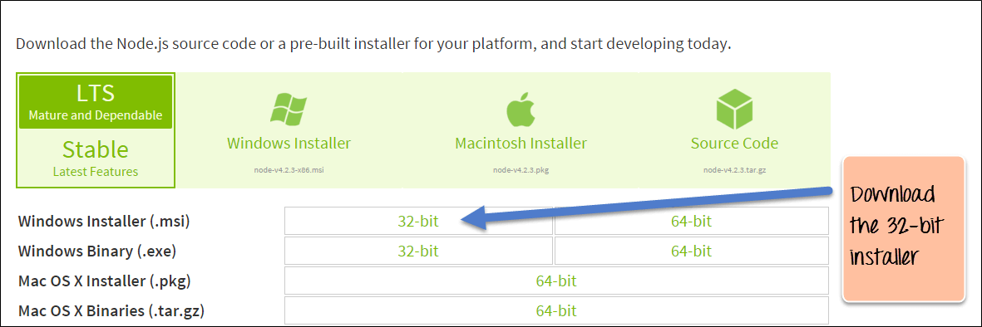
Install Node.js
Go to the site https://nodejs.org/en/download/

Slide 7
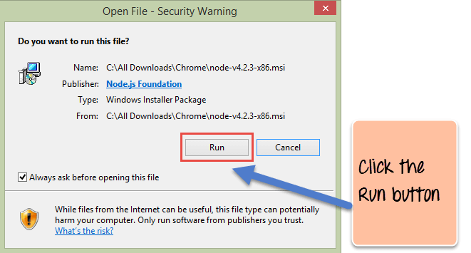

Slide 8
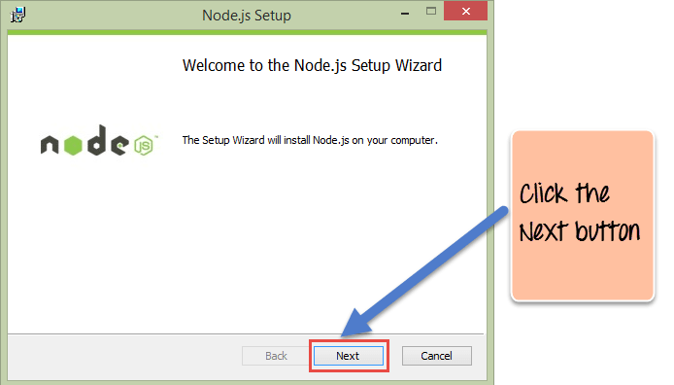
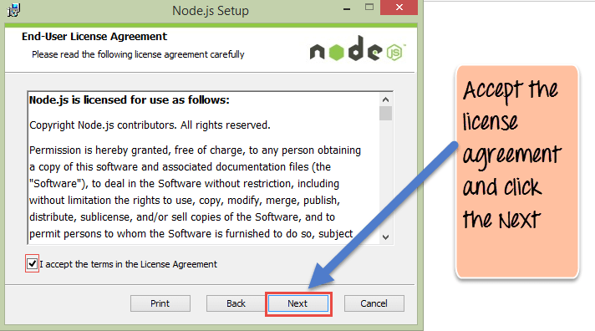

Slide 9
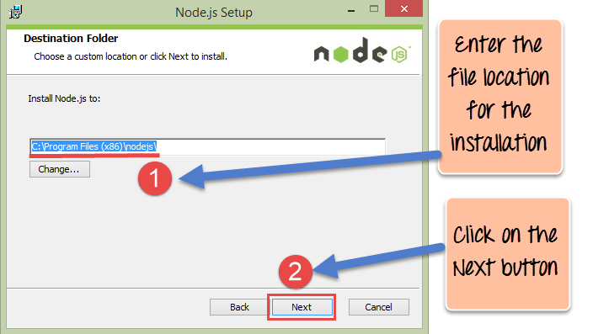
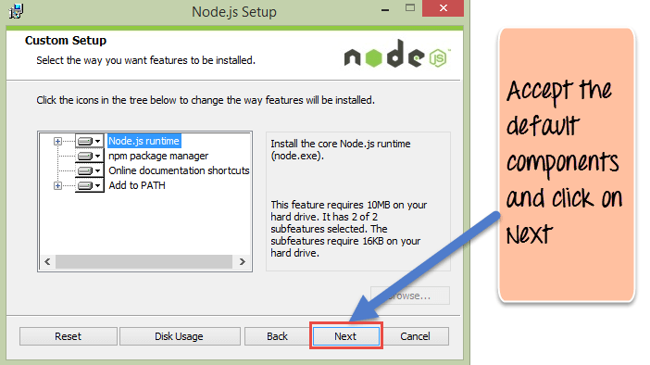

Slide 10
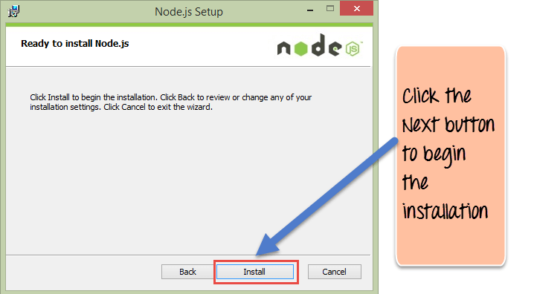
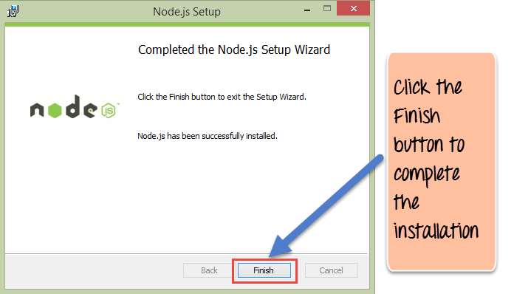

Slide 11
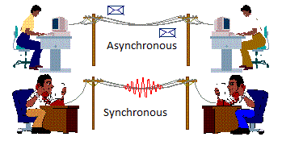
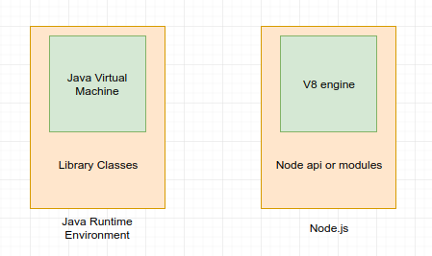
Features
Asynchronous event driven IO helps concurrent request handling.
Single Threaded but highly scalable
The Node.js library used JavaScript.
Node uses the V8 JavaScript Runtime engine, the one which is used by Google Chrome. Node has a wrapper over the JavaScript engine.
Notes:
Node.js itself is a C++ implementation of a V8 engine allowing server-side programming and networking applications.

Slide 12
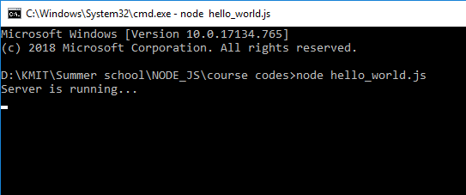
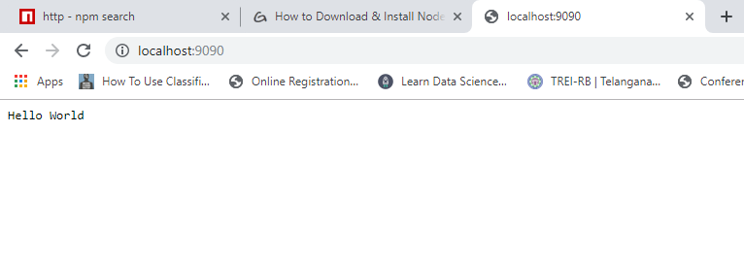
First Hello world application in Node.js
const http = require('http');
const server = http.createServer (
function f1(request, response)
{
response.write('Hello World\n');
response.end();
}
);
server.listen(9090, function()
{
console.log('Server is running...');
}
);

Slide 13
Modules in Node.js
A module in Node.js is a logical encapsulation of code in a single unit.
Each module is an independent entity.
It can be managed as a separate unit of work.
popular modules of Node js application:
Express framework
MongoDB
File system
Nodemailer
url
Notes:
It's always a good programming practice to always segregate code in such a way that makes it more manageable and maintainable for future purposes.

Slide 14
NPM Modules
To use modules in Node.js application:-
We need to install modules using npm (node package manager).
The npm provides a link between node package registry and our development environment.
https://www.npmjs.com/
Any module can be installed by using following command
npm install package_name
Once the module has been installed, to use that module in a Node.js application we need to use the 'require' keyword.
'require' keyword incorporate the functionality of a module in an application.

Slide 15
Nodemon
Nodemon monitors your file changes .
Nodemon is used to auto restart a node.
To get nodemon module:
npm install –g nodemon
After performing some changes to the file, save it.
Then save event is triggered
Then save event is received by nodemon, so that it automatically restarts the server.

Slide 16
Introduction to Express.js
Express is one of the module in NPM registry.
Express.js is a Node js web application server framework.
The Express.js framework makes very easy to develop an application
Express can be used to handle multiple types of requests like the GET, PUT, and POST and DELETE requests.

Slide 17
Installing Express
Express gets installed via the Node Package manager.
This can be done by executing the following line in the command line
npm install express

Slide 18
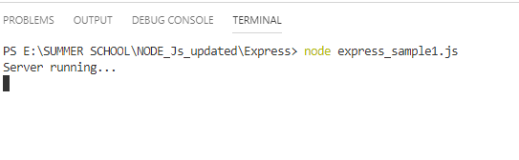
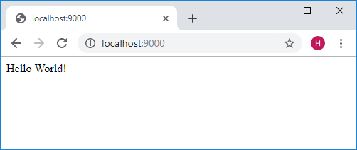
Sample program using Express
var express=require('express');
var app=express();
app.get('/',function(req,res)
{
res.send('Hello World!');
});
app.listen(9000,function()
{
console.log("Server running...");
});

Slide 19
Routes
Routing refers for determining the way in which an application responds to a client request to a particular endpoint.
A client can make http request for various URL's.
http://localhost:3000/mean
https://shopforaurelia.com/bottom-wear.html
Based on the URL which is accessed
A different functionality on the web server will be invoked
Accordingly the response will be sent to the client.

Slide 20
Routes (cont…)
The general syntax for a route is
app.METHOD(PATH, HANDLER)
app is an instance of the express module
METHOD is an HTTP request method (GET, POST, PUT or DELETE)
PATH is a path on the server.
HANDLER is the function executed when the route is matched.

Slide 21
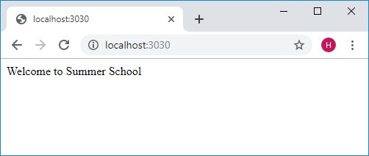
Example
var express = require('express');
var app = express();
app.listen (3030, () =>
{
console.log('listening on 3030')
});
app.get('/',function(req,res)
{
res.send('Welcome to Summer School');
});

Slide 22
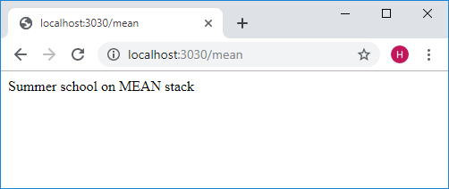
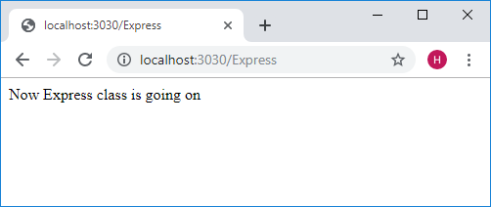
Example (cont…)
app.get( '/mean', function(req,res)
{
res.send("Summer school on MEAN stack");
});
app.get( '/Express', function(req,res)
{
res.send("Now Express class is going on");
});

Slide 23
package.json in a module
The "package.json" file is used to hold the metadata about a particular project.
This information provides the Node package manager the necessary information.
The package.json files contains information such as
the project description
the version of the project in a particular distribution
license information
configuration data
It is included with following statement
npm init

Slide 24
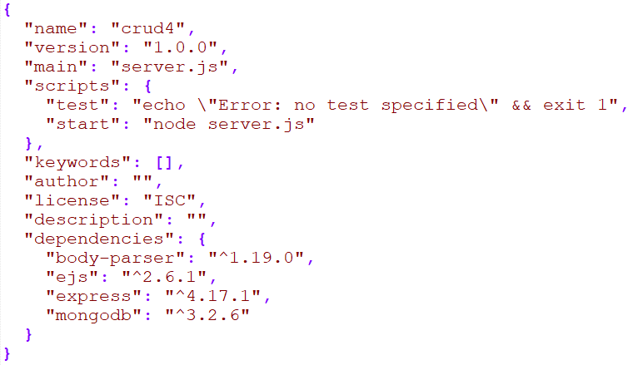
Example

Slide 25
EJS (Embedded JavaScript)
EJS is a simple templating language that lets you generate HTML markup with plain JavaScript.
JavaScript code is simple and straightforward with scriptlet tags.
<% 'Scriptlet' tag, for control-flow, no output
<%= Outputs the value into the template
%> Plain ending tag
EJS write JavaScript that emits the HTML which performs a dynamic task.
EJS gets installed via the Node Package manager.
npm install ejs

Slide 26
Example which connects client with node.js (express)
index.ejs
<!DOCTYPE html>
<html lang="en">
<head>
<meta charset="UTF-8">
<title>MY APP</title>
<link rel="stylesheet" href="styles.css">
</head>
<body>
<h3>Users</h3>
<ul>
<% for(var i=0; i<users.length; i++) {%>
<li class="user">
<span><%= users[i] %></span>
</li>
<% } %>
</ul>
</body>
</html>

Slide 27
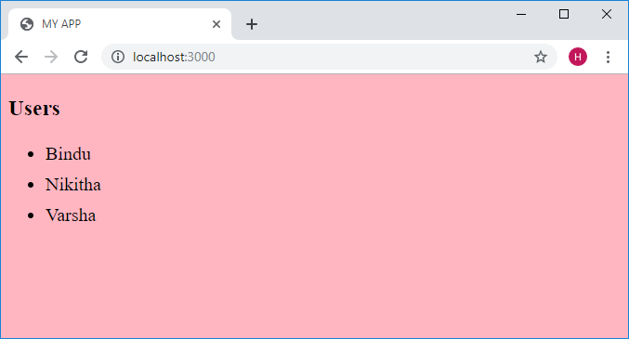
server.js
const express = require('express')
const app = express() app.listen(3000, () =>
{
console.log('listening on 3000')
}
);
app.set('view engine', 'ejs')
app.use(express.static('public'))
var result = ['Bindu','Nikitha','Varsha'];
app.get('/', (req, res) => {
res.render('index.ejs', {users: result})
})

Slide 28
INSTALLATION OF MONGODB
To install mongoDB, go to this link and click on the appropriate OS and architecture: http://www.mongodb.org/downloads
Click on downloaded file and start installing.
After installation click on next till you get Finish button.
Create a data directory on C:\ for mongoDB to use i.e. “data” followed by “data\db”.
Open your mongodb/bin directory and run mongod.exe to start the database server.
To establish a connection to the server, open another command prompt window and go to the same directory, entering in mongo.exe. This engages the mongodb shell.

Slide 29
Node js with Mongo-DB
The Node js framework has the ability to work with databases.
Mongo Db can store any sort of content and particularly in any sort of format.
The tasks can be performed by using mongo DB module:
Create and close a connection to a database.
Queries can be executed to get data.
Data manipulation such as inserting data, deleting and updating data can also be achieved.
npm install mongodb@2.2.33
Notes:
Node js can work with both relational (such as Oracle and MS SQL Server) and non-relational databases (such as MongoDB).

Slide 30
Database connection with Node JS
const MongoClient = require('mongodb').MongoClient;
const url = 'mongodb://localhost:27017/employee_db';
MongoClient.connect( url, (err, database) => {
if (err) return console.log(err)
console.log('Connected')
//database.close();
})

Slide 31
Inserting documents in a collection
var MongoClient = require('mongodb').MongoClient;
var url = 'mongodb://localhost:27017/employee_db';
MongoClient.connect(url, function(err, db) {
if (err) return console.log(err);
db.collection('employee').insertOne({
empid: 4,
empname: "John",
empsalary:32000
}, function(err,result){
if(err) throw err;
console.log("1 data inserted succesfully")
})
});

Slide 32
Retrieving documents from MongoDB database
var MongoClient = require('mongodb').MongoClient;
var url = 'mongodb://localhost:27017/employee_db';
MongoClient.connect(url, function(err, db) {
if (err) return console.log(err);
var cursor=db.collection('employee').find();
cursor.each(function(err,doc){
console.log(doc);
})
}
);

Slide 33
Updating documents in a collection
var MongoClient = require('mongodb').MongoClient;
var url = 'mongodb://localhost/employee_db';
MongoClient.connect(url, function(err, db) {
db.collection('employee').updateOne({
"empname": "Mohan"
}, {
$set: {
"empsalary": 45000
}
},function(err,result){
if(err) throw err;
console.log("1 data updated succesfully");
});
});

Slide 34
Deleting documents in a collection
var MongoClient = require('mongodb').MongoClient;
var url = 'mongodb://localhost/employee_db';
MongoClient.connect(url, function(err, db) {
db.collection('employee').deleteOne({
"empname": "Mohan"
},function(err,result){
if(err) throw err;
console.log("1 data deleted succesfully");
});
});

